Slide 1



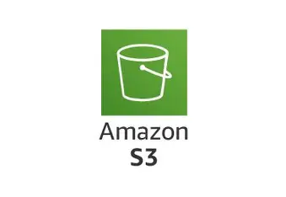
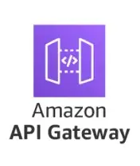
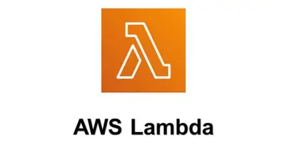
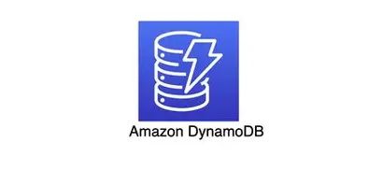
Serverless Lead Capture Web Application
Professional web presence. Zero maintenance.
Event Management Website .
By Monish Kumar V

Slide 2
Architectural Overview and Frontend Implementation
Project Goal : To demonstrate a modern, scalable, and cost-effective method for hosting a static website and capturing user input using AWS Serverless technologies.
Key Focus Areas :
1. AWS Service Integration.
2. Frontend Implementation (HTML/CSS/JS).
3. Securing Cross-Origin Requests (CORS).

Slide 3

Why Serverless?
Zero Maintenance
Cost Efficient
No servers to patch, monitor, or scale manually
Pay only for what you use, not idle capacity
Enterprise Security
AWS-managed encryption and compliance built-in

Slide 4

The Architecture
S3 Website
API Gateway
Lambda Function
DynamoDB

Slide 5

Static Site on Amazon S3
Fast & Reliable
Your website is hosted as a static site directly on S3. Lightning-fast content delivery globally with 99.99% uptime SLA.
Automatic scaling for traffic spikes
Global content distribution
Built-in redundancy
Hosts all static assets (.html, .css, .js, images). Configured for
public access as a website endpoint.

Slide 6

API Gateway: Your Security Gatekeeper
Robust Protection
Provides a publicly accessible REST API endpoint for the contact form. Configures the essential CORS headers and serves as a firewall/router to Lambda.
Cross-Origin Resource Sharing (CORS) policies
A security mechanism used by browsers to prevent a script loaded
from one domain (S3 website) from interacting with a resource from a
different domain (API Gateway).
Note : Essential because the frontend domain (S3) is different from
the backend domain (API Gateway). Without correct CORS, the form
request fails immediately.

Slide 7

AWS Lambda : Backend Logic & Processing
Executes the Python code. Receives form data via Lambda Proxy Integration, validates the input, and prepares the record for the database.
On-Demand Execution
Data Validation
Python function runs only when a lead arrives—no idle costs
Automatically checks and sanitizes all incoming inquiries
Seamless Integration
Directly writes cleaned data to DynamoDB database

Slide 8

AWS IAM (Identity and Access Management) : Security & Permissions
Manages the IAM Role for the Lambda function, granting it necessary permissions (and only those permissions) to write data to the specific DynamoDB table.
AWSLambdaBasicExecutionRole :
Allows the Lambda function to create and write logs to the /aws/lambda/BlackTigerHandleContactFormFunction log group in CloudWatch.
AmazonDynamoDBFullAccess :
Grants permission to perform Read/Write operations (dynamodb:PutItem, dynamodb:GetItem, etc.) on all DynamoDB tables.

Slide 9

AWS DynamoDB: Data Storage
Scales infinitely with your growth. A fully managed NoSQL database used for
storing captured client inquiries, ensuring high availability and scalability.
Enterprise-Grade Storage
BlackTigerContactQueriesTable securely stores every lead with encryption at rest. Automatic backups ensure you never lose prospect data.
Encrypted data storage
Automatic daily backups
Instant query retrieval

Slide 10
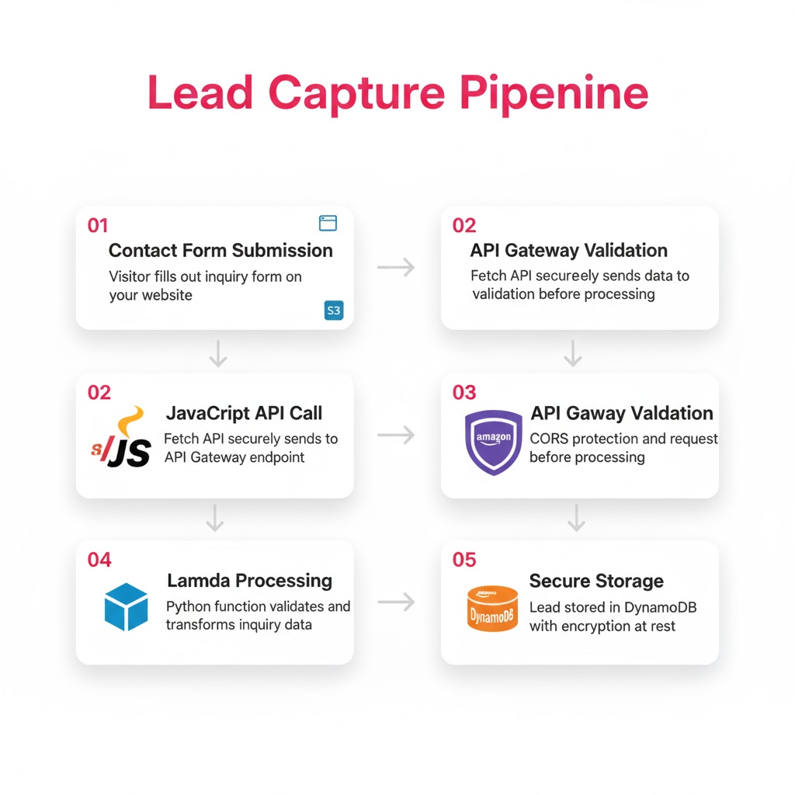
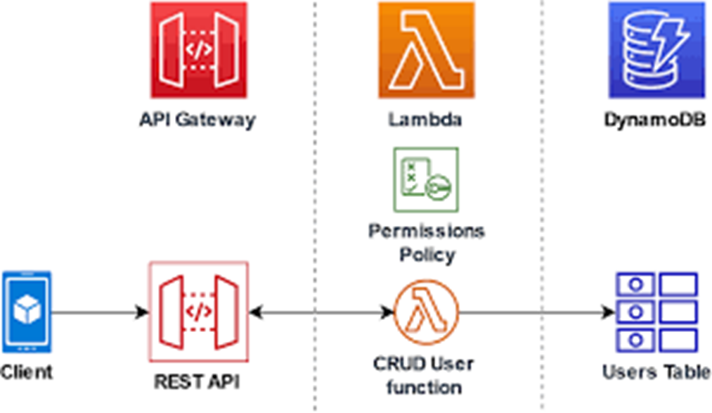

Slide 11
Frontend Languages :
HTML5 : Provides the basic structure and content of the web pages (index.html, contact.html)
CSS3 (Cascading Style Sheets): Controls the visual presentation and styling of the website.
JavaScript : Handles the interactivity and API communication.
Backend Language (Serverless Logic):
Python (Executed by AWS Lambda): Executes the serverless logic for data processing and database interaction.

Slide 12
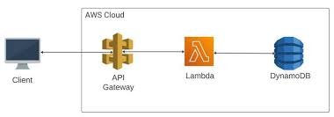
Step to Configure
1. Hosting Setup (Amazon S3)
Create S3 Bucket: Create a new S3 bucket with a globally unique name (e.g., blacktigers-website-2025).
Enable Static Website Hosting: Go to the Properties tab of the bucket, enable Static Website Hosting, set the Index document to index.html, and note the Endpoint URL.
Configure Bucket Policy: Edit the Permissions tab and set a Bucket Policy to allow public read access (essential for a static website).
Upload Files: Upload all frontend files (index.html, contact.html, style.css, script.js, and images) to the root of the bucket.

Slide 13
2. Database Creation (Amazon DynamoDB)
Create Table: Create a new DynamoDB table named BlackTigerContactQueriesTable.
Define Primary Key: Set the primary partition key to queryId (String). This will be used to uniquely identify each client inquiry.
3. Backend Logic (AWS Lambda)
Create Execution Role (IAM): Create a new IAM role (e.g., BlackTigerLambdaDynamoRole) with a trust relationship for lambda.amazonaws.com. Attach the AWSLambdaBasicExecutionRole policy (for CloudWatch logs) and a Custom Policy granting dynamodb:PutItem permission restricted to the BlackTigerContactQueriesTable.
Create Lambda Function: Create a new Lambda function using the Python runtime. Assign it the BlackTigerLambdaDynamoRole you just created.
Deploy Code: Write and deploy the Python code that handles the API request, extracts the JSON data (name, email, query), generates a queryId, and uses the Boto3 library to perform the PutItem operation on the DynamoDB table.

Slide 14
4. API Endpoint (AWS API Gateway)
Create REST API: Create a new REST API.
Create Resource: Create a resource named /contact on the root of your API.
Create Method (POST): Create a POST method under the /contact resource.
Integration Setup: Set the Integration Type to Lambda Function and select your BlackTigerHandleContactFormFunction. Enable Lambda Proxy Integration.
Configure CORS: Select the /contact resource and enable CORS. This is critical: set Access-Control-Allow-Origin to your S3 bucket's domain (or * if testing) to allow the frontend to communicate with the API.
Deploy API: Deploy the API to a new stage (e.g., prod). Note the Invoke URL—you will paste this into your script.js.
5. Final Connection (Frontend Code Update)
Update JavaScript: Open your script.js file.
Paste Invoke URL: Replace the placeholder API_BASE_URL with the Invoke URL obtained from your API Gateway deployment stage.
Re-upload: Upload the updated script.js file back to your S3 bucket.

Slide 15

Ready to Scale
Professional website. Automatic lead capture. Zero server maintenance. Enterprise security.
✓ Live & Secure
✓ Lead Generation
✓ Peace of Mind
Website hosted globally on S3
Every inquiry automatically captured and stored
AWS manages infrastructure, you manage growth

Slide 16
Thank You

